Slide 1
Force Field Parameterization of a Small Molecule
Hemanth Haridas
Clark Group
Department of Chemistry
University of Utah
Email: hemanth.haridas@utah.edu

Slide 2
CHARMM Force Field
Initially developed in the research group of Prof. Martin Karplus
Mainly focus on biomolecules (proteins, DNA and carbohydrates)
Currently being expanded to include materials.
Compatible with many MD codes: NAMD, LAMMPS and GROMACS
Requires two types of files: a topology file (top_all36*) and parameter file (par_all36*)

Slide 3
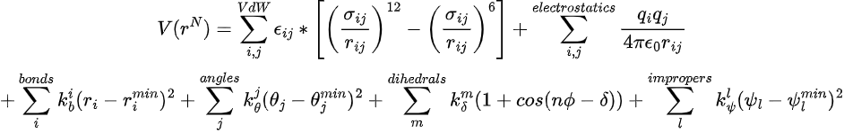
What is CHARMM Force Field?
BONDS
atomtype1 atomtype2 fc r_min
CG1N1 CG2R61 345.00 1.4350
Force constants for bonds > Force constants for angles > Force constants for dihedrals
Why??
ANGLES
atomtype1 atomtype2 atomtype3 fc theta_min
CG2R61 CG1N1 NG1T1 40.00 180.00
Conformational transitions in biomolecules are controlled by dihedral torsions
DIHEDRALS
atomtype1 atomtype2 atomtype3 atomtype4 fc n phi_min
CG2R53 CG251O CG25C1 CG2R53 6.4000 2 180.00

Slide 4
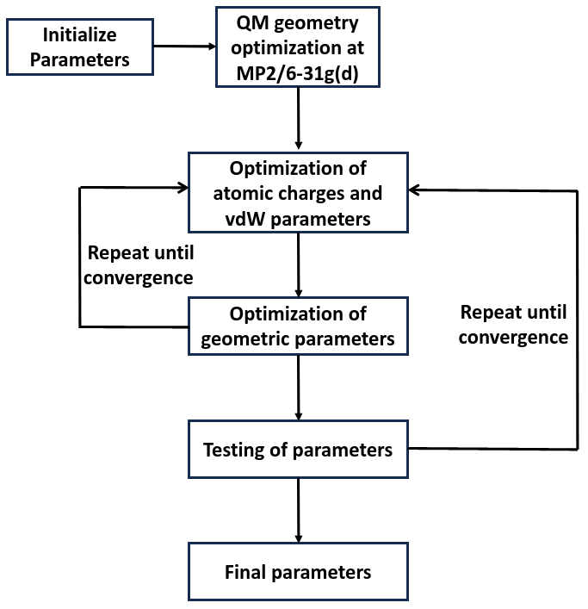
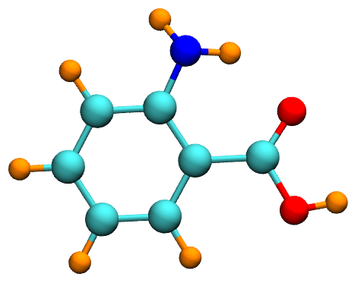
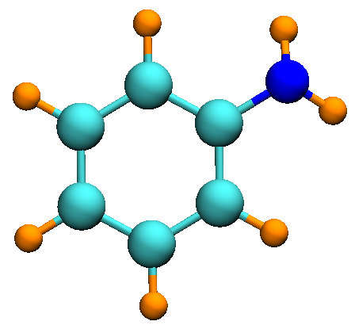
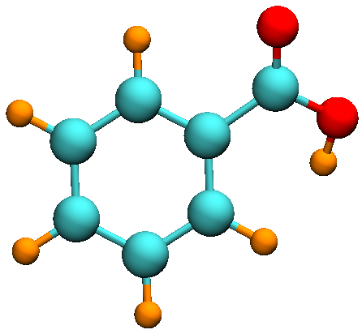
CHARMM Parameterization Strategy

Slide 5
CHARMM Parameterization Workflow
Optimizing Dihedrals
Modify step3_dihe.inp according to instructions.
Prepare input files for lsfit according to instructions.
Run lsfitpar according to instructions.
Modify mol.str file and rerun step3_dihe.inp
Obtain convergence.
Building the Molecule
Copy files from /ocean/projects/see220002p/shared/charmm_tutorials
Change directory to mm_files
Modify step1_build.inp according to instructions (edit breakpoints)
Obtain the correct crd, psf and pdb files.
Optimizing Partial Charges
Modify step2_water.inp according to instructions (edit breakpoints)
Compare the MM energies with QM energies (provided in qm_files/water)
Rerun step2_water.inp after modifying partial charges in mol.str file
Obtain convergence

Slide 6
Charge Fitting
Fitting Partial Charges
Generate QM Target Data
Generate MM Data
Update MM charges
No
Converged?
Yes
Final Parameters

Slide 7
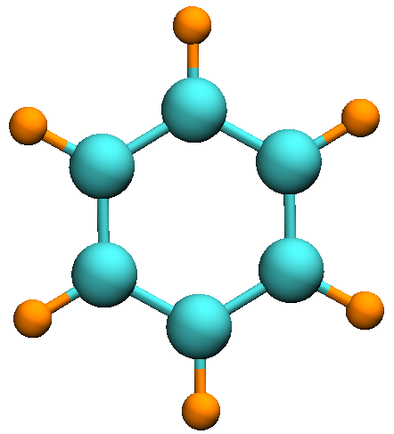
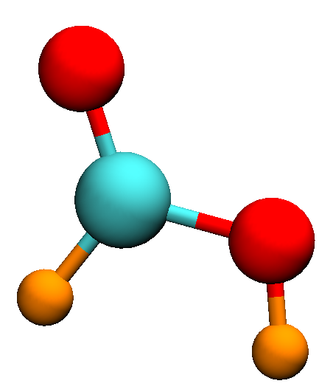
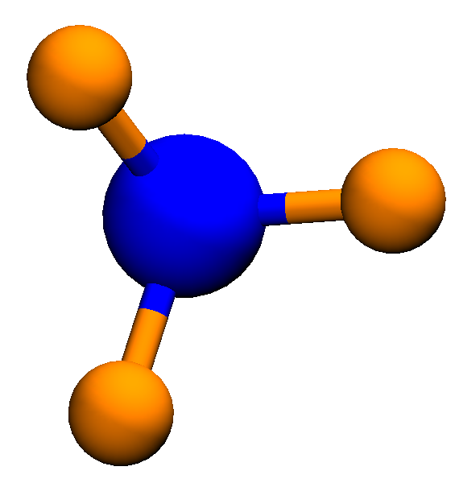
How good are the parameters?
The parameters are transferred based on chemical similarity from the CHARMM parameter library.
Each transfer is then assigned a penalty depending on how close are the chemical environments in the target and source molecules.

Slide 8
Testing Geometric Parameters
Fitting Bonded Parameters
MM minimized Geometry
Check convergence
Initial Guess from Transferred Parameters
QM optimized Geometry

Slide 9
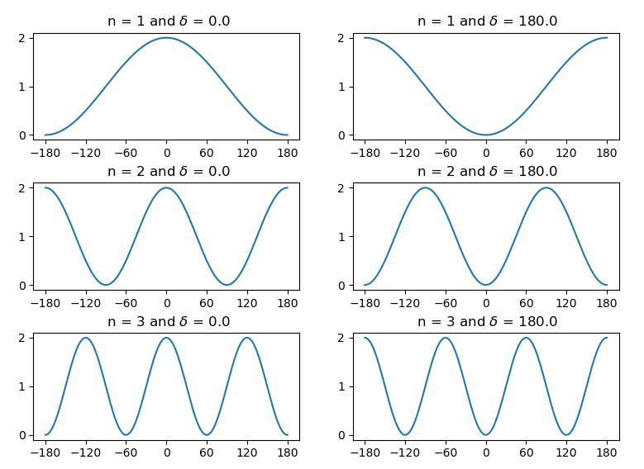
Dihedral Fitting

Slide 10
Dihedral Fitting
Generate QM Target Data
Generate MM0 Target Data
Run lsfit to get new dihedral parameters
Update multiplicity and (or) delta
No
Transfer and test the parameters
Converged
Yes
Final Parameters

